Slide 1
Business Analytics
Notes:
Title - The learning outcome
Subtitle - Duration

Slide 2
In this section, we will discuss:
Probability Theories
Bayes’ Theorem
Maximum Likelihood
Hypothesis Testing
Central limit theorem
Chi-square test
Notes:
Mention the parent topics one by one. This particular learning outcome has 4 parent topics.

Slide 3
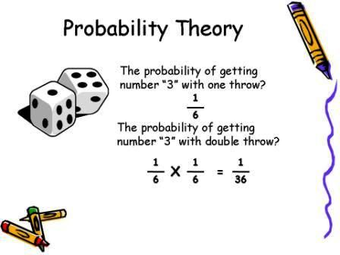
Probability Theories
What Is Probability Theory?
Probability theory is a branch of mathematics focusing on the analysis of random phenomena. It is an important skill for data scientists using data affected by chance.
Image Source: https://i.pinimg.com/originals/c7/44/33/c74433effae9a094ff059a6d016d547b.jpg
Notes:
Left (White Color space):
Title - Parent Topic
Subtitle - Subtopic 1
Body Text - Description in bullets
Right (Grey Color Space):
Body Text - Relevant image (with source)/code snippet
Put reference links in Speaker Notes
Reference:
https://www.tutorialspoint.com/internet_technologies/internet_overview.htm/

Slide 4
Probability Theories
Practical Uses for Probability Theory
Data scientists to model situations
Business world
Business world
Clinical trials
Image Source: https://i.pinimg.com/originals/c7/44/33/c74433effae9a094ff059a6d016d547b.jpg
Notes:
Left (White Color space):
Title - Parent Topic
Subtitle - Subtopic 1
Body Text - Description in bullets
Right (Grey Color Space):
Body Text - Relevant image (with source)/code snippet
Put reference links in Speaker Notes
Reference:
https://www.tutorialspoint.com/internet_technologies/internet_overview.htm/

Slide 5
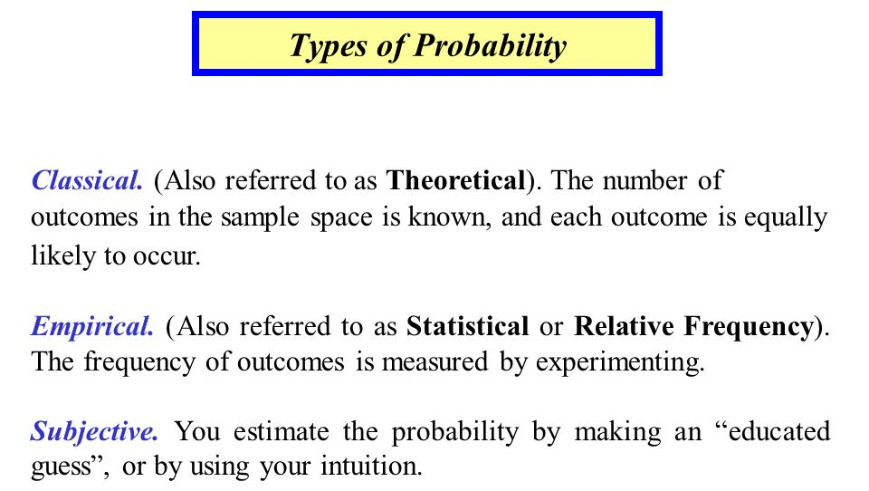
Probability Theories
Types of Probability?
Classical
Relative Frequency
Subjective Probability
Image Source: https://slideplayer.com/slide/6379961/22/images/3/Types+of+Probability.jpg
Notes:
Left (White Color space):
Title - Parent Topic
Subtitle - Subtopic 1
Body Text - Description in bullets
Right (Grey Color Space):
Body Text - Relevant image (with source)/code snippet
Put reference links in Speaker Notes
Reference:
https://www.tutorialspoint.com/internet_technologies/internet_overview.htm/

Slide 6
Probability Theories
Probability Theory Examples
Probability theory is a tool employed by researchers, businesses, investment analysts and countless others for risk management and scenario analysis.
Epidemiology
Insurance
Small Business
Meteorology
Image Source: https://i.pinimg.com/originals/c7/44/33/c74433effae9a094ff059a6d016d547b.jpg
Notes:
Left (White Color space):
Title - Parent Topic
Subtitle - Subtopic 1
Body Text - Description in bullets
Right (Grey Color Space):
Body Text - Relevant image (with source)/code snippet
Put reference links in Speaker Notes
Reference:
https://www.tutorialspoint.com/internet_technologies/internet_overview.htm/

Slide 7
Probability Theories
Advantages and Disadvantages of Probability Theory
Classical
Relative Frequency
Subjective
Image Source: https://slideplayer.com/slide/6379961/22/images/3/Types+of+Probability.jpg
Notes:
Left (White Color space):
Title - Parent Topic
Subtitle - Subtopic 1
Body Text - Description in bullets
Right (Grey Color Space):
Body Text - Relevant image (with source)/code snippet
Put reference links in Speaker Notes
Reference:
https://www.tutorialspoint.com/internet_technologies/internet_overview.htm/

Slide 8
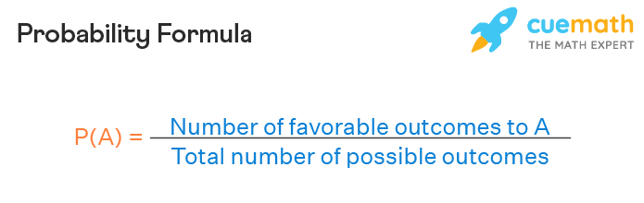
Probability Theories
What is the probability formula?
P(A) = favorable outcomes/total outcomes
Image Source: https://d138zd1ktt9iqe.cloudfront.net/media/seo_landing_files/probability-formula-1-1634878086.png
Notes:
Left (White Color space):
Title - Parent Topic
Subtitle - Subtopic 1
Body Text - Description in bullets
Right (Grey Color Space):
Body Text - Relevant image (with source)/code snippet
Put reference links in Speaker Notes
Reference:
https://www.tutorialspoint.com/internet_technologies/internet_overview.htm/

Slide 9
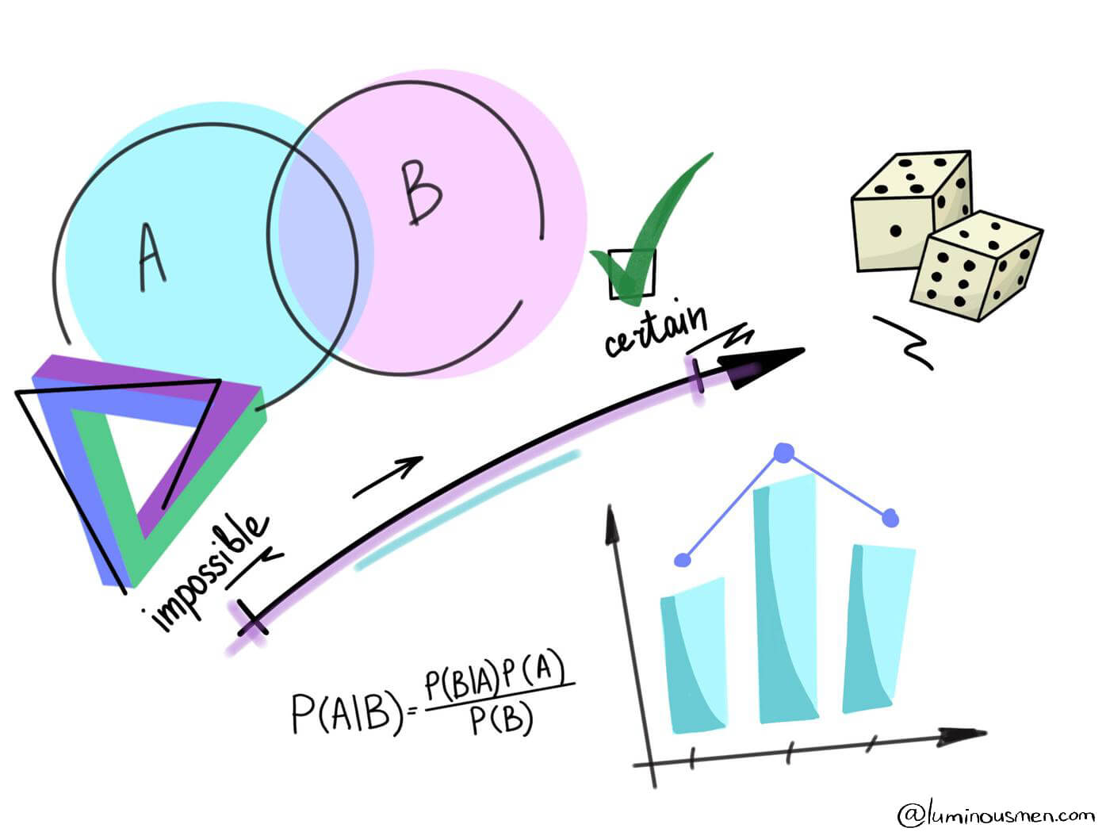
Probability Theories
How Data Scientists Use Probability Theory
Probability allows data scientists to assess the certainty of outcomes of a particular study or experiment.
Today’s data scientists need to have an understanding of the foundational concepts of probability theory including key concepts involving probability distribution, statistical significance, hypothesis testing and regression.
Image Source: https://luminousmen.com/media/data-science-probability_2.jpg
Notes:
Left (White Color space):
Title - Parent Topic
Subtitle - Subtopic 1
Body Text - Description in bullets
Right (Grey Color Space):
Body Text - Relevant image (with source)/code snippet
Put reference links in Speaker Notes
Reference:
https://www.tutorialspoint.com/internet_technologies/internet_overview.htm/

Slide 10
Bayes’ Theorem
What is the Bayes’ Theorem?
The Bayes’ theorem is a mathematical formula used to determine the conditional probability of events. Essentially, the Bayes’ theorem describes the probability of an event based on prior knowledge of the conditions that might be relevant to the event.
Image Source: : https://cdn.corporatefinanceinstitute.com/assets/bayes-theorem.png
Notes:
Left (White Color space):
Title - Parent Topic
Subtitle - Subtopic 1
Body Text - Description in bullets
Right (Grey Color Space):
Body Text - Relevant image (with source)/code snippet
Put reference links in Speaker Notes
Reference:
https://www.tutorialspoint.com/internet_technologies/internet_overview.htm/

Slide 11
Bayes’ Theorem
Formula for Bayes’ Theorem
Where:
P(A|B) – the probability of event A occurring, given event B has occurred
P(B|A) – the probability of event B occurring, given event A has occurred
P(A) – the probability of event A
P(B) – the probability of event B
Image Source: : https://cdn.corporatefinanceinstitute.com/assets/bayes-theorem1.png
Notes:
Left (White Color space):
Title - Parent Topic
Subtitle - Subtopic 1
Body Text - Description in bullets
Right (Grey Color Space):
Body Text - Relevant image (with source)/code snippet
Put reference links in Speaker Notes
Reference:
https://www.tutorialspoint.com/internet_technologies/internet_overview.htm/

Slide 12
Bayes’ Theorem
Formula for Bayes’ Theorem
A special case of the Bayes’ theorem is when event A is a binary variable. In such a case, the theorem is expressed in the following way
Where:
•P(B|A–) – the probability of event B occurring given that event A– has occurred
•P(B|A+) – the probability of event B occurring given that event A+ has occurred
Image Source: https://cdn.corporatefinanceinstitute.com/assets/bayes-theorem2-600x97.png
Notes:
Left (White Color space):
Title - Parent Topic
Subtitle - Subtopic 1
Body Text - Description in bullets
Right (Grey Color Space):
Body Text - Relevant image (with source)/code snippet
Put reference links in Speaker Notes
Reference:
https://www.tutorialspoint.com/internet_technologies/internet_overview.htm/

Slide 13
Bayes’ Theorem
Example of Bayes’ Theorem
Using the Bayes’ theorem, we can find the required probability:
Image Source: https://cdn.corporatefinanceinstitute.com/assets/bayes-theorem3.png
Notes:
Left (White Color space):
Title - Parent Topic
Subtitle - Subtopic 1
Body Text - Description in bullets
Right (Grey Color Space):
Body Text - Relevant image (with source)/code snippet
Put reference links in Speaker Notes
Reference:
https://www.tutorialspoint.com/internet_technologies/internet_overview.htm/

Slide 14
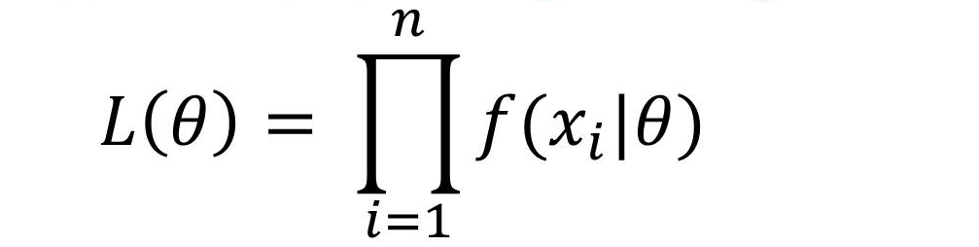
Maximum likelihood
What is Maximum likelihood
Maximum likelihood is a widely used technique for estimation with applications in many areas including time series modeling, panel data, discrete data, and even machine learning.
Image Source: https://4.bp.blogspot.com/-FewCGHC23oU/WliHLS_APPI/AAAAAAAAAv8/gyvldpT8aG4VEPVu6DnqhIXoSaBg0F_YgCLcBGAs/s1600/Maximum-Likelihood-Estimation-in-Machine-Learning.jpg
Notes:
Left (White Color space):
Title - Parent Topic
Subtitle - Subtopic 1
Body Text - Description in bullets
Right (Grey Color Space):
Body Text - Relevant image (with source)/code snippet
Put reference links in Speaker Notes
Reference:
https://www.tutorialspoint.com/internet_technologies/internet_overview.htm/

Slide 15
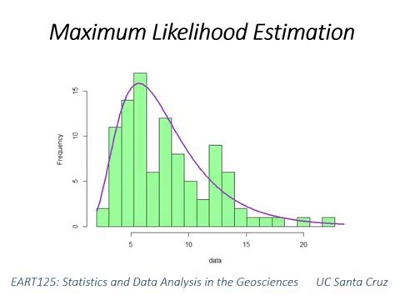
Maximum likelihood
What is Maximum Likelihood Estimation?
Maximum likelihood estimation is a statistical method for estimating the parameters of a model. In maximum likelihood estimation, the parameters are chosen to maximize the likelihood that the assumed model results in the observed data.
Image Source: https://i.ytimg.com/vi/2vh98ful3_M/hqdefault.jpg
Notes:
Left (White Color space):
Title - Parent Topic
Subtitle - Subtopic 1
Body Text - Description in bullets
Right (Grey Color Space):
Body Text - Relevant image (with source)/code snippet
Put reference links in Speaker Notes
Reference:
https://www.tutorialspoint.com/internet_technologies/internet_overview.htm/

Slide 16
Maximum likelihood
What is Maximum Likelihood Estimation?
In order to implement maximum likelihood estimation we must:
Assume a model, also known as a data generating process, for our data.
Be able to derive the likelihood function for our data, given our assumed model (we will discuss this more later).
Image Source: https://i.ytimg.com/vi/2vh98ful3_M/hqdefault.jpg
Notes:
Left (White Color space):
Title - Parent Topic
Subtitle - Subtopic 1
Body Text - Description in bullets
Right (Grey Color Space):
Body Text - Relevant image (with source)/code snippet
Put reference links in Speaker Notes
Reference:
https://www.tutorialspoint.com/internet_technologies/internet_overview.htm/

Slide 17
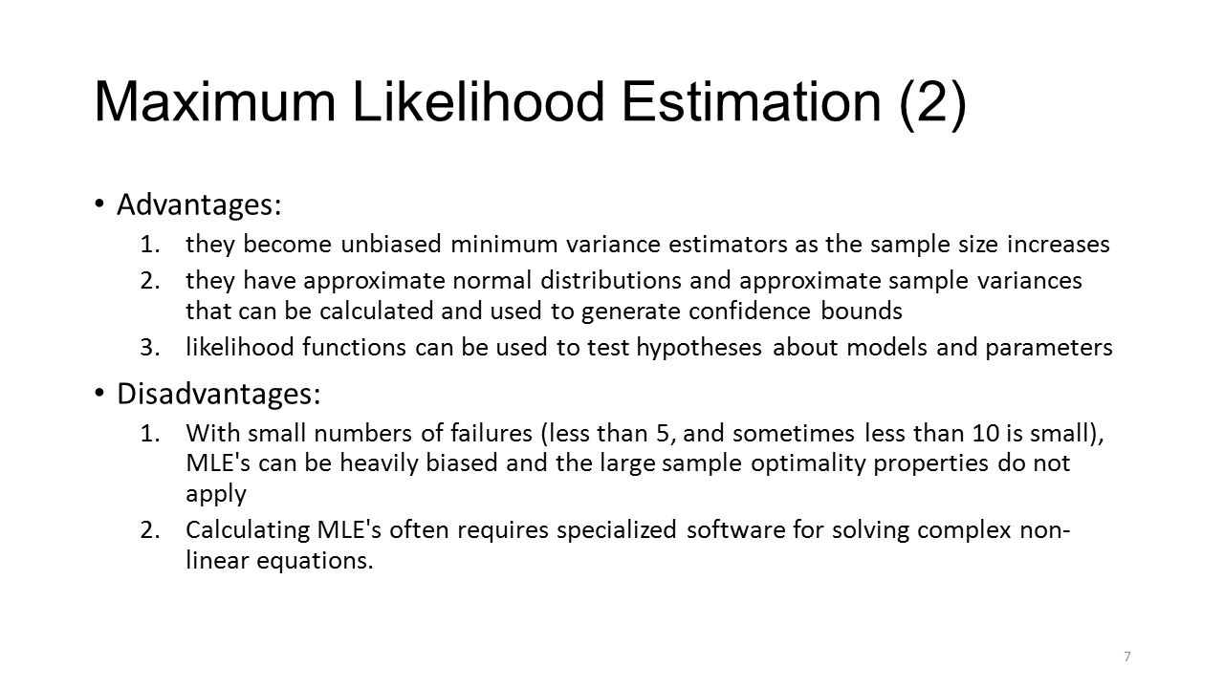
Maximum likelihood
Advantages of Maximum Likelihood Estimation
If the model is correctly assumed, the maximum likelihood estimator is the most efficient estimator.
It provides a consistent but flexible approach which makes it suitable for a wide variety of applications, including cases where assumptions of other models are violated.
It results in unbiased estimates in larger samples.
Image Source: https://images.slideplayer.com/35/10494584/slides/slide_7.jpg
Notes:
Left (White Color space):
Title - Parent Topic
Subtitle - Subtopic 1
Body Text - Description in bullets
Right (Grey Color Space):
Body Text - Relevant image (with source)/code snippet
Put reference links in Speaker Notes
Reference:
https://www.tutorialspoint.com/internet_technologies/internet_overview.htm/

Slide 18
Maximum likelihood
Disadvantages of Maximum Likelihood Estimation
It relies on the assumption of a model and the derivation of the likelihood function which is not always easy.
Like other optimization problems, maximum likelihood estimation can be sensitive to the choice of starting values.
Image Source: https://images.slideplayer.com/35/10494584/slides/slide_7.jpg
Notes:
Left (White Color space):
Title - Parent Topic
Subtitle - Subtopic 1
Body Text - Description in bullets
Right (Grey Color Space):
Body Text - Relevant image (with source)/code snippet
Put reference links in Speaker Notes
Reference:
https://www.tutorialspoint.com/internet_technologies/internet_overview.htm/

Slide 19
Maximum likelihood
Disadvantages of Maximum Likelihood Estimation
Depending on the complexity of the likelihood function, the numerical estimation can be computationally expensive.
Estimates can be biased in small samples.
Image Source: https://images.slideplayer.com/35/10494584/slides/slide_7.jpg
Notes:
Left (White Color space):
Title - Parent Topic
Subtitle - Subtopic 1
Body Text - Description in bullets
Right (Grey Color Space):
Body Text - Relevant image (with source)/code snippet
Put reference links in Speaker Notes
Reference:
https://www.tutorialspoint.com/internet_technologies/internet_overview.htm/

Slide 20
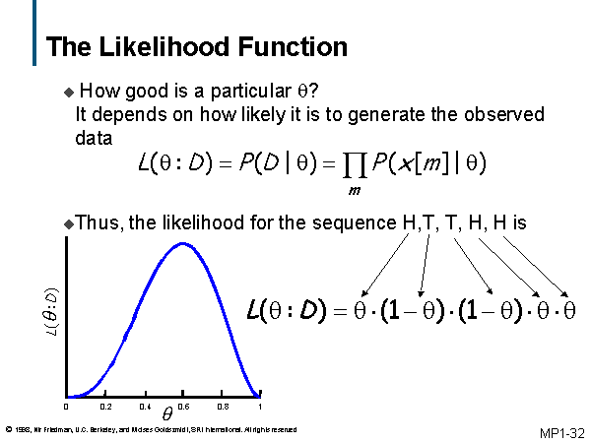
Maximum likelihood
What is the Likelihood Function?
Maximum likelihood estimation hinges on the derivation of the likelihood function. For this reason, it is important to have a good understanding of what the likelihood function is and where it comes from.
Let's start with the very simple case where we have one series with 10 independent observations: 5, 0, 1, 1, 0, 3, 2, 3, 4, 1.
Image Source: http://ai.stanford.edu/~moises/tutorial/img032.GIF
Notes:
Left (White Color space):
Title - Parent Topic
Subtitle - Subtopic 1
Body Text - Description in bullets
Right (Grey Color Space):
Body Text - Relevant image (with source)/code snippet
Put reference links in Speaker Notes
Reference:
https://www.tutorialspoint.com/internet_technologies/internet_overview.htm/

Slide 21
What is the Likelihood Function?
The Probability Density
The first step in maximum likelihood estimation is to assume a probability distribution for the data. A probability density function measures the probability of observing the data given a set of underlying model parameters.
Image Source: http://ai.stanford.edu/~moises/tutorial/img032.GIF
Notes:
Left (White Color space):
Title - Parent Topic
Subtitle - Subtopic 1
Body Text - Description in bullets
Right (Grey Color Space):
Body Text - Relevant image (with source)/code snippet
Put reference links in Speaker Notes
Reference:
https://www.tutorialspoint.com/internet_technologies/internet_overview.htm/

Slide 22
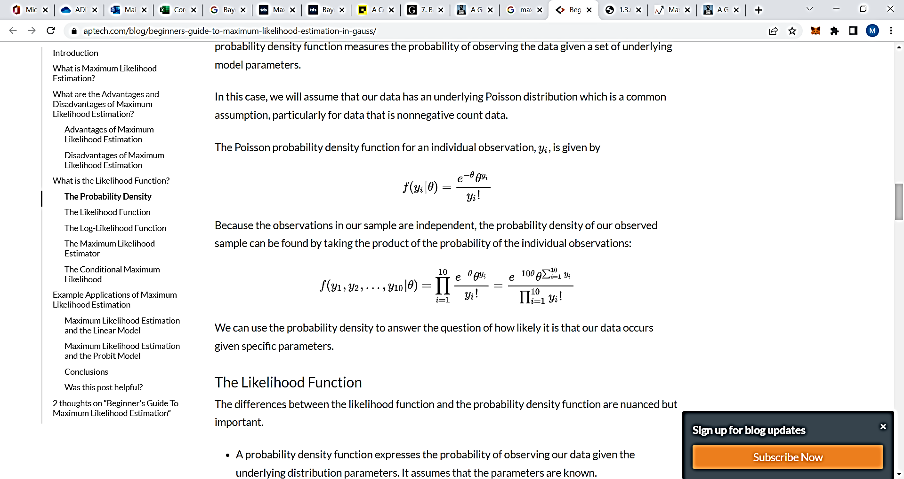
What is the Likelihood Function?
The Probability Density
The Poisson probability density function for an individual observation, is given by
Because the observations in our sample are independent, the probability density of our observed sample can be found by taking the product of the probability of the individual observations:
Image Source: http://ai.stanford.edu/~moises/tutorial/img032.GIF
Notes:
Left (White Color space):
Title - Parent Topic
Subtitle - Subtopic 1
Body Text - Description in bullets
Right (Grey Color Space):
Body Text - Relevant image (with source)/code snippet
Put reference links in Speaker Notes
Reference:
https://www.tutorialspoint.com/internet_technologies/internet_overview.htm/

Slide 23
What is the Likelihood Function?
The Likelihood Function
The differences between the likelihood function and the probability density function are nuanced but important.
A probability density function expresses the probability of observing our data given the underlying distribution parameters. It assumes that the parameters are known.
Image Source: http://ai.stanford.edu/~moises/tutorial/img032.GIF
Notes:
Left (White Color space):
Title - Parent Topic
Subtitle - Subtopic 1
Body Text - Description in bullets
Right (Grey Color Space):
Body Text - Relevant image (with source)/code snippet
Put reference links in Speaker Notes
Reference:
https://www.tutorialspoint.com/internet_technologies/internet_overview.htm/

Slide 24
What is the Likelihood Function?
The Likelihood Function
The likelihood function expresses the likelihood of parameter values occurring given the observed data. It assumes that the parameters are unknown.
Image Source: http://ai.stanford.edu/~moises/tutorial/img032.GIF
Notes:
Left (White Color space):
Title - Parent Topic
Subtitle - Subtopic 1
Body Text - Description in bullets
Right (Grey Color Space):
Body Text - Relevant image (with source)/code snippet
Put reference links in Speaker Notes
Reference:
https://www.tutorialspoint.com/internet_technologies/internet_overview.htm/

Slide 25
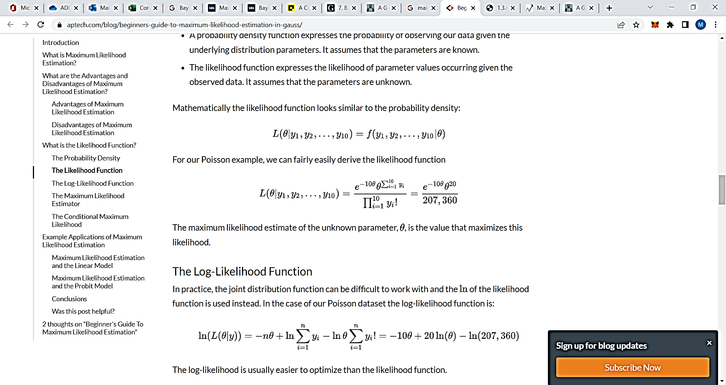
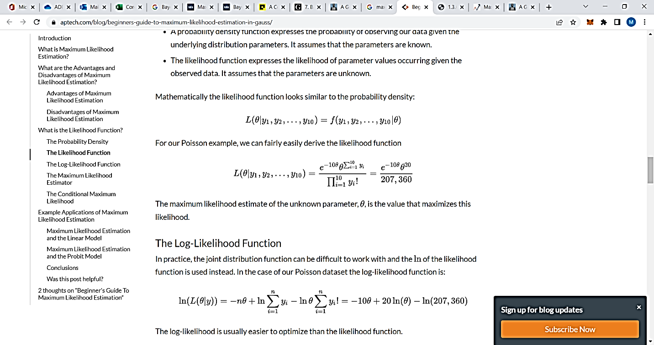
What is the Likelihood Function?
The Likelihood Function
Mathematically the likelihood function looks similar to the probability density:
For our Poisson example, we can fairly easily derive the likelihood function
Image Source: http://ai.stanford.edu/~moises/tutorial/img032.GIF
Notes:
Left (White Color space):
Title - Parent Topic
Subtitle - Subtopic 1
Body Text - Description in bullets
Right (Grey Color Space):
Body Text - Relevant image (with source)/code snippet
Put reference links in Speaker Notes
Reference:
https://www.tutorialspoint.com/internet_technologies/internet_overview.htm/

Slide 26

What is the Likelihood Function?
The Log-Likelihood Function
In practice, the joint distribution function can be difficult to work with and the of the likelihood function is used instead. In the case of our Poisson dataset the log-likelihood function is:
Image Source: http://ai.stanford.edu/~moises/tutorial/img032.GIF
Notes:
Left (White Color space):
Title - Parent Topic
Subtitle - Subtopic 1
Body Text - Description in bullets
Right (Grey Color Space):
Body Text - Relevant image (with source)/code snippet
Put reference links in Speaker Notes
Reference:
https://www.tutorialspoint.com/internet_technologies/internet_overview.htm/

Slide 27
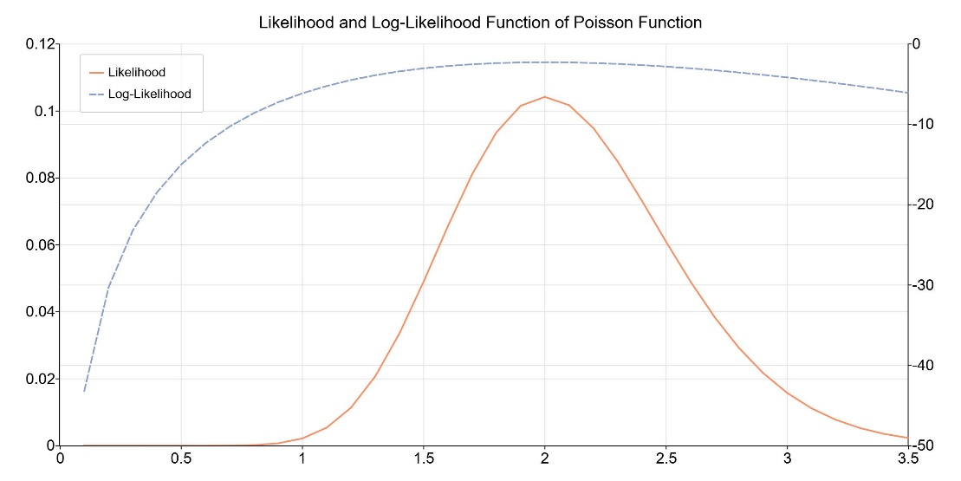
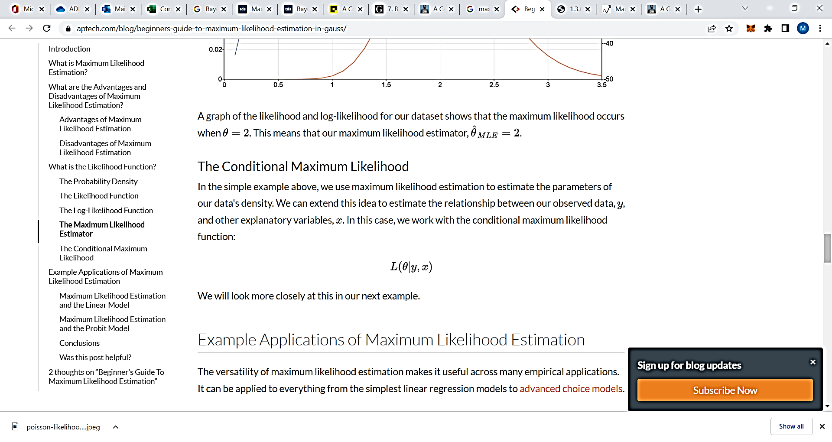
What is the Likelihood Function?
The Maximum Likelihood Estimator
A graph of the likelihood and log-likelihood for our dataset shows that the maximum likelihood occurs when θ= 2. This means that our maximum likelihood estimator,
Image Source: https://www.aptech.com/wp-content/uploads/2020/09/poisson-likelihood-function.jpeg
Notes:
Left (White Color space):
Title - Parent Topic
Subtitle - Subtopic 1
Body Text - Description in bullets
Right (Grey Color Space):
Body Text - Relevant image (with source)/code snippet
Put reference links in Speaker Notes
Reference:
https://www.tutorialspoint.com/internet_technologies/internet_overview.htm/

Slide 28
What is the Likelihood Function?
 | MLE | Bayesian Estimation
Predictions | We make predictions utilizing the latent variables in the density function to compute a probability. | We make predictions using the posterior distribution and the parameters which are considered as the random variables.
Situations to working with | Data with minimal values and the knowledge of prior is low. We can use MLE. | Data with sparse value and knowledge about the reliability of priors is high. We can use Bayesian estimation.
Complexity | MLE is less complex because we require to compute only the likelihood function | Bayesian estimation is more complex because the computation requires the likelihood function, evidence, and prior.
Maximum Likelihood Estimation (MLE) vs Bayesian Estimation.
Maximum Likelihood Estimation (MLE) vs Bayesian Estimation.
Notes:
Left (White Color space):
Title - Parent Topic
Subtitle - Subtopic 1
Body Text - Description in bullets
Right (Grey Color Space):
Body Text - Relevant image (with source)/code snippet
Put reference links in Speaker Notes
Reference:
https://www.tutorialspoint.com/internet_technologies/internet_overview.htm/

Slide 29
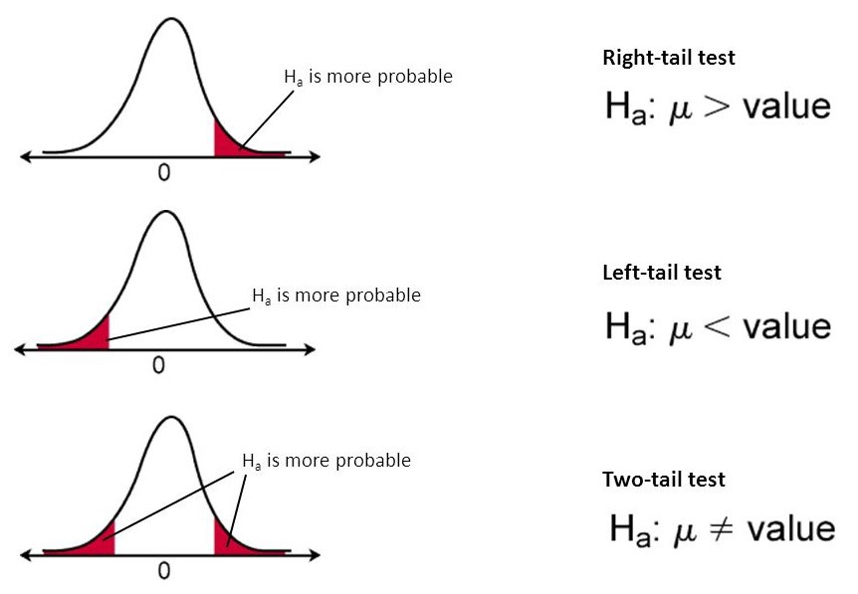
Hypothesis Testing
What Is Hypothesis Testing?
Hypothesis testing is an act in statistics whereby an analyst tests an assumption regarding a population parameter. The methodology employed by the analyst depends on the nature of the data used and the reason for the analysis.
https://miro.medium.com/max/862/1*VXxdieFiYCgR6v7nUaq01g.jpeg
Image Source: https://miro.medium.com/max/862/1*VXxdieFiYCgR6v7nUaq01g.jpeg
Notes:
Left (White Color space):
Title - Parent Topic
Subtitle - Subtopic 1
Body Text - Description in bullets
Right (Grey Color Space):
Body Text - Relevant image (with source)/code snippet
Put reference links in Speaker Notes
Reference:
https://www.tutorialspoint.com/internet_technologies/internet_overview.htm/

Slide 30
Hypothesis Testing
What Is Hypothesis Testing?
Hypothesis testing is used to assess the plausibility of a hypothesis by using sample data. Such data may come from a larger population, or from a data-generating process. The word "population" will be used for both of these cases in the following descriptions.
Image Source: https://miro.medium.com/max/862/1*VXxdieFiYCgR6v7nUaq01g.jpeg
Notes:
Left (White Color space):
Title - Parent Topic
Subtitle - Subtopic 1
Body Text - Description in bullets
Right (Grey Color Space):
Body Text - Relevant image (with source)/code snippet
Put reference links in Speaker Notes
Reference:
https://www.tutorialspoint.com/internet_technologies/internet_overview.htm/

Slide 31
Hypothesis Testing
What Is Hypothesis Testing?
Hypothesis testing is used to assess the plausibility of a hypothesis by using sample data.
The test provides evidence concerning the plausibility of the hypothesis, given the data.
Statistical analysts test a hypothesis by measuring and examining a random sample of the population being analyzed.
Image Source: https://miro.medium.com/max/862/1*VXxdieFiYCgR6v7nUaq01g.jpeg
Notes:
Left (White Color space):
Title - Parent Topic
Subtitle - Subtopic 1
Body Text - Description in bullets
Right (Grey Color Space):
Body Text - Relevant image (with source)/code snippet
Put reference links in Speaker Notes
Reference:
https://www.tutorialspoint.com/internet_technologies/internet_overview.htm/

Slide 32
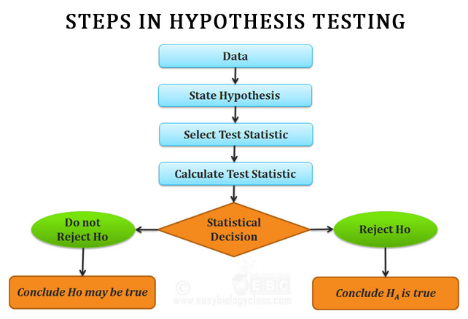
Hypothesis Testing
How Hypothesis Testing Works
In hypothesis testing, an analyst tests a statistical sample, with the goal of providing evidence on the plausibility of the null hypothesis.
Statistical analysts test a hypothesis by measuring and examining a random sample of the population being analyzed.
Image Source: https://miro.medium.com/max/642/0*EsLPwer1RYCSczmw
Notes:
Left (White Color space):
Title - Parent Topic
Subtitle - Subtopic 1
Body Text - Description in bullets
Right (Grey Color Space):
Body Text - Relevant image (with source)/code snippet
Put reference links in Speaker Notes
Reference:
https://www.tutorialspoint.com/internet_technologies/internet_overview.htm/

Slide 33
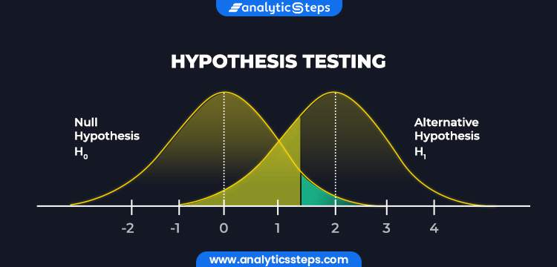
Hypothesis Testing
Types of Hypothesis Testing
There are two types of Hypothesis Testing
Null hypothesis
Alternative hypothesis
Image Source: https://www.analyticssteps.com/backend/media/thumbnail/6735922/4237247_1626434645_HYPOTHESIS%20TESTINGArtboard%201.jpg
Notes:
Left (White Color space):
Title - Parent Topic
Subtitle - Subtopic 1
Body Text - Description in bullets
Right (Grey Color Space):
Body Text - Relevant image (with source)/code snippet
Put reference links in Speaker Notes
Reference:
https://www.tutorialspoint.com/internet_technologies/internet_overview.htm/

Slide 34
Hypothesis Testing
Types of Hypothesis Testing
Null Hypothesis: It is denoted by H0. A null hypothesis is the one in which sample observations result purely from chance. This means that the observations are not influenced by some non-random cause.
Image Source: https://www.analyticssteps.com/backend/media/thumbnail/6735922/4237247_1626434645_HYPOTHESIS%20TESTINGArtboard%201.jpg
Notes:
Left (White Color space):
Title - Parent Topic
Subtitle - Subtopic 1
Body Text - Description in bullets
Right (Grey Color Space):
Body Text - Relevant image (with source)/code snippet
Put reference links in Speaker Notes
Reference:
https://www.tutorialspoint.com/internet_technologies/internet_overview.htm/

Slide 35
Hypothesis Testing
Types of Hypothesis Testing
Alternative Hypothesis: It is denoted by Ha or H1. An alternative hypothesis is the one in which sample observations are influenced by some non-random cause. A hypothesis test concludes whether to reject the null hypothesis and accept the alternative hypothesis or to fail to reject the null hypothesis. The decision is based on the value of X and R.
Image Source: https://www.analyticssteps.com/backend/media/thumbnail/6735922/4237247_1626434645_HYPOTHESIS%20TESTINGArtboard%201.jpg
Notes:
Left (White Color space):
Title - Parent Topic
Subtitle - Subtopic 1
Body Text - Description in bullets
Right (Grey Color Space):
Body Text - Relevant image (with source)/code snippet
Put reference links in Speaker Notes
Reference:
https://www.tutorialspoint.com/internet_technologies/internet_overview.htm/

Slide 36
Hypothesis Testing
Steps in Hypothesis Testing
Stating the Hypotheses
Making Statistical Assumptions
Formulating an Analysis Plan
Investigating Sample Data
Interpreting Results
Image Source: https://miro.medium.com/max/642/0*EsLPwer1RYCSczmw
Notes:
Left (White Color space):
Title - Parent Topic
Subtitle - Subtopic 1
Body Text - Description in bullets
Right (Grey Color Space):
Body Text - Relevant image (with source)/code snippet
Put reference links in Speaker Notes
Reference:
https://www.tutorialspoint.com/internet_technologies/internet_overview.htm/

Slide 37
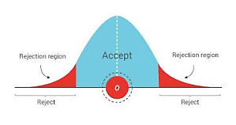
Hypothesis Testing
Accepting or Rejecting Null Hypothesis
This is an extension of the last step - interpreting results in the process of hypothesis testing. A null hypothesis is accepted or rejected basis P value and the region of acceptance.
P value – it is a function of the observed sample results.
Image Source: https://i0.wp.com/www.iedunote.com/img/25143/hypothesis-testing.png?resize=299%2C158&quality=100&ssl=1
Notes:
Left (White Color space):
Title - Parent Topic
Subtitle - Subtopic 1
Body Text - Description in bullets
Right (Grey Color Space):
Body Text - Relevant image (with source)/code snippet
Put reference links in Speaker Notes
Reference:
https://www.tutorialspoint.com/internet_technologies/internet_overview.htm/

Slide 38
Central limit theorem
What is the Central Limit Theorem (CLT)?
The Central Limit Theorem (CLT) is a statistical concept that states that the sample mean distribution of a random variable will assume a near-normal or normal distribution if the sample size is large enough.
Image Source: https://cdn.corporatefinanceinstitute.com/assets/Central-Limit-Theorem-CLT-Diagram-1200x734.png
Notes:
Left (White Color space):
Title - Parent Topic
Subtitle - Subtopic 1
Body Text - Description in bullets
Right (Grey Color Space):
Body Text - Relevant image (with source)/code snippet
Put reference links in Speaker Notes
Reference:
https://www.tutorialspoint.com/internet_technologies/internet_overview.htm/

Slide 39
Central limit theorem
How Does the Central Limit Theorem Work?
The central limit theorem forms the basis of the probability distribution. It makes it easy to understand how population estimates behave when subjected to repeated sampling. When plotted on a graph, the theorem shows the shape of the distribution formed by means of repeated population samples.
Image Source: https://cdn.corporatefinanceinstitute.com/assets/Central-Limit-Theorem-CLT-How-it-works-and-how-it-arises.png
Notes:
Left (White Color space):
Title - Parent Topic
Subtitle - Subtopic 1
Body Text - Description in bullets
Right (Grey Color Space):
Body Text - Relevant image (with source)/code snippet
Put reference links in Speaker Notes
Reference:
https://www.tutorialspoint.com/internet_technologies/internet_overview.htm/

Slide 40
Central limit theorem
How Does the Central Limit Theorem Work?
From the figure above, we can deduce that despite the fact that the original shape of the distribution was uniform, it tends towards a normal distribution as the value of n (sample size) increases.
Image Source: https://cdn.corporatefinanceinstitute.com/assets/Central-Limit-Theorem-CLT-How-it-works-and-how-it-arises.png
Notes:
Left (White Color space):
Title - Parent Topic
Subtitle - Subtopic 1
Body Text - Description in bullets
Right (Grey Color Space):
Body Text - Relevant image (with source)/code snippet
Put reference links in Speaker Notes
Reference:
https://www.tutorialspoint.com/internet_technologies/internet_overview.htm/

Slide 41
Central limit theorem
How Does the Central Limit Theorem Work?
Apart from showing the shape that the sample means will take, the central limit theorem also gives an overview of the mean and variance of the distribution. The sample mean of the distribution is the actual population mean from which the samples were taken.
Image Source: https://cdn.corporatefinanceinstitute.com/assets/Central-Limit-Theorem-CLT-How-it-works-and-how-it-arises.png
Notes:
Left (White Color space):
Title - Parent Topic
Subtitle - Subtopic 1
Body Text - Description in bullets
Right (Grey Color Space):
Body Text - Relevant image (with source)/code snippet
Put reference links in Speaker Notes
Reference:
https://www.tutorialspoint.com/internet_technologies/internet_overview.htm/

Slide 42
Central limit theorem
How Does the Central Limit Theorem Work?
The variance of the sample distribution, on the other hand, is the variance of the population divided by n. Therefore, the larger the sample size of the distribution, the smaller the variance of the sample mean.
Image Source: https://cdn.corporatefinanceinstitute.com/assets/Central-Limit-Theorem-CLT-How-it-works-and-how-it-arises.png
Notes:
Left (White Color space):
Title - Parent Topic
Subtitle - Subtopic 1
Body Text - Description in bullets
Right (Grey Color Space):
Body Text - Relevant image (with source)/code snippet
Put reference links in Speaker Notes
Reference:
https://www.tutorialspoint.com/internet_technologies/internet_overview.htm/

Slide 43
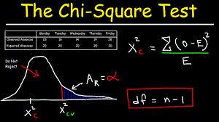
Chi-square test
What Is a Chi-Square Statistic?
A chi-square (χ2) statistic is a test that measures how a model compares to actual observed data. The data used in calculating a chi-square statistic must be random, raw, mutually exclusive, drawn from independent variables, and drawn from a large enough sample.
Image Source: https://i.ytimg.com/vi/HKDqlYSLt68/maxresdefault.jpg
Notes:
Left (White Color space):
Title - Parent Topic
Subtitle - Subtopic 1
Body Text - Description in bullets
Right (Grey Color Space):
Body Text - Relevant image (with source)/code snippet
Put reference links in Speaker Notes
Reference:
https://www.tutorialspoint.com/internet_technologies/internet_overview.htm/

Slide 44
Chi-square test
What Is a Chi-Square Statistic?
Chi-square tests are often used in hypothesis testing.
The chi-square statistic compares the size of any discrepancies between the expected results and the actual results, given the size of the sample and the number of variables in the relationship.
Image Source: https://i.ytimg.com/vi/HKDqlYSLt68/maxresdefault.jpg
Notes:
Left (White Color space):
Title - Parent Topic
Subtitle - Subtopic 1
Body Text - Description in bullets
Right (Grey Color Space):
Body Text - Relevant image (with source)/code snippet
Put reference links in Speaker Notes
Reference:
https://www.tutorialspoint.com/internet_technologies/internet_overview.htm/

Slide 45
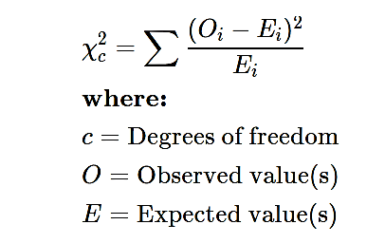
Chi-square test
The Formula for Chi-Square Is
Image Source: https://i.ytimg.com/vi/HKDqlYSLt68/maxresdefault.jpg
Notes:
Left (White Color space):
Title - Parent Topic
Subtitle - Subtopic 1
Body Text - Description in bullets
Right (Grey Color Space):
Body Text - Relevant image (with source)/code snippet
Put reference links in Speaker Notes
Reference:
https://www.tutorialspoint.com/internet_technologies/internet_overview.htm/

Slide 46
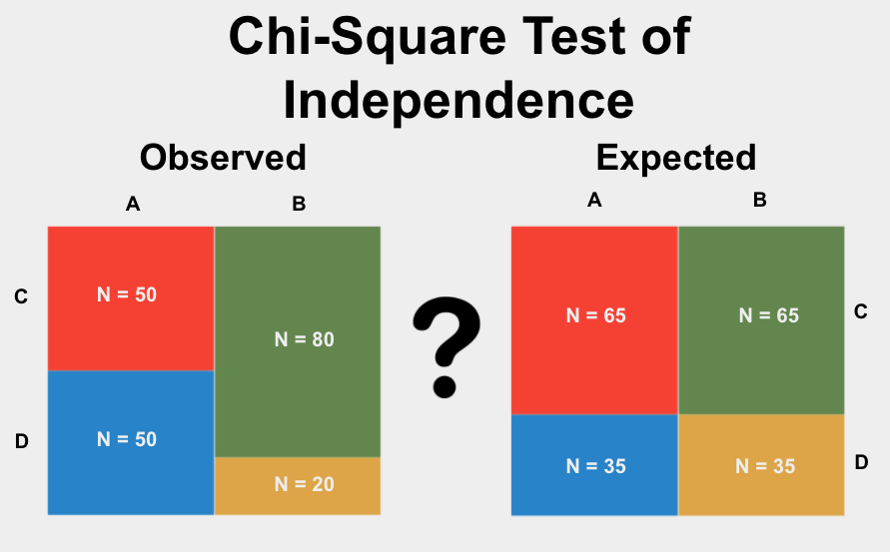
Chi-square test
What Does a Chi-Square Statistic Tell You?
There are two main kinds of chi-square tests:
The test of independence, which asks a question of relationship, such as, "Is there a relationship between student sex and course choice?";
Image Source: https://www.statstest.com/wp-content/uploads/2020/10/Chi-Square-Test-of-Independence-1.jpg
Notes:
Left (White Color space):
Title - Parent Topic
Subtitle - Subtopic 1
Body Text - Description in bullets
Right (Grey Color Space):
Body Text - Relevant image (with source)/code snippet
Put reference links in Speaker Notes
Reference:
https://www.tutorialspoint.com/internet_technologies/internet_overview.htm/

Slide 47
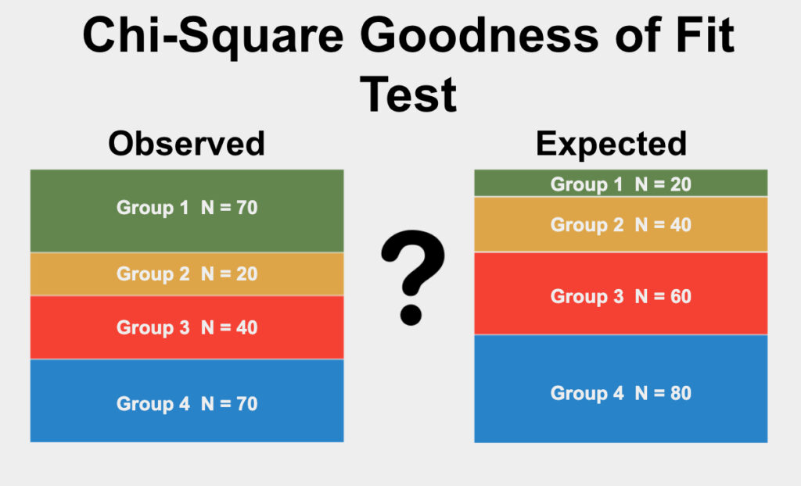
Chi-square test
What Does a Chi-Square Statistic Tell You?
The goodness-of-fit test, which asks something like "How well does the coin in my hand match a theoretically fair coin?"
Chi-square analysis is applied to categorical variables and is especially useful when those variables are nominal (where order doesn't matter, like marital status or gender).
Image Source: https://www.statstest.com/wp-content/uploads/2020/09/Chi-Square-Goodness-of-Fit-Test-1024x622.jpg
Notes:
Left (White Color space):
Title - Parent Topic
Subtitle - Subtopic 1
Body Text - Description in bullets
Right (Grey Color Space):
Body Text - Relevant image (with source)/code snippet
Put reference links in Speaker Notes
Reference:
https://www.tutorialspoint.com/internet_technologies/internet_overview.htm/

Slide 48
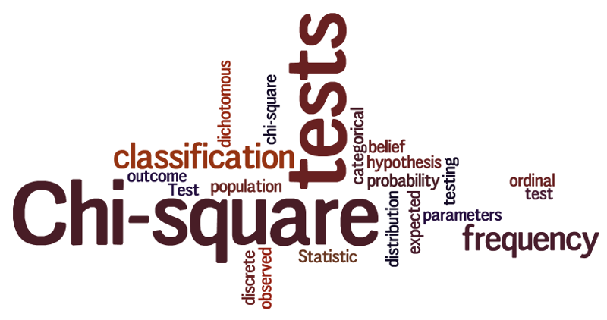
Chi-square test
What is a chi-square test used for?
Chi-square is a statistical test used to examine the differences between categorical variables from a random sample in order to judge goodness of fit between expected and observed results.
Image Source: https://encrypted-tbn0.gstatic.com/images?q=tbn:ANd9GcR7Hd2uJDxTmKlfIWnu_U6Hqz4X8J5DRfRewA&usqp=CAU
Notes:
Left (White Color space):
Title - Parent Topic
Subtitle - Subtopic 1
Body Text - Description in bullets
Right (Grey Color Space):
Body Text - Relevant image (with source)/code snippet
Put reference links in Speaker Notes
Reference:
https://www.tutorialspoint.com/internet_technologies/internet_overview.htm/

Slide 49
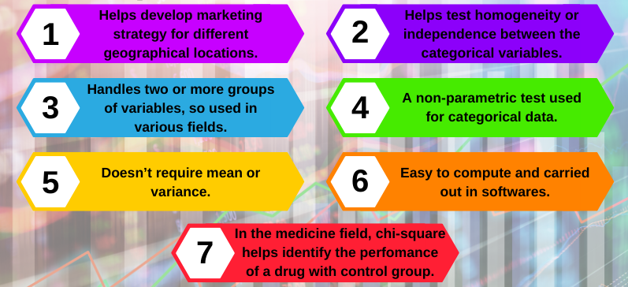
Chi-square test
Who uses chi-square analysis?
Researchers
Nominal or Ordinal variable
Image Source: https://statswork.com/blog/wp-content/uploads/2019/10/chi-square-infographics.png
Notes:
Left (White Color space):
Title - Parent Topic
Subtitle - Subtopic 1
Body Text - Description in bullets
Right (Grey Color Space):
Body Text - Relevant image (with source)/code snippet
Put reference links in Speaker Notes
Reference:
https://www.tutorialspoint.com/internet_technologies/internet_overview.htm/

